Slide 1
Using MINIO object storage for digital preservation tasks
Jonáš Svatoš, Head of Digital Laboratory
Národní filmový archiv, Prague
No Time To Wait! #4
Budapest, 6.12.2019
Notes:
Hello, my name is Jonáš Svatoš, and I work at Narodni filmovy archiv in Prague on digitization and digital preservation of audiovisual heritage.
This short overview wil be about leveraging the concept of so-called 'Object-storage' model towards easier access to AV data, mainly with respect to parallelization and data safety.

Slide 2
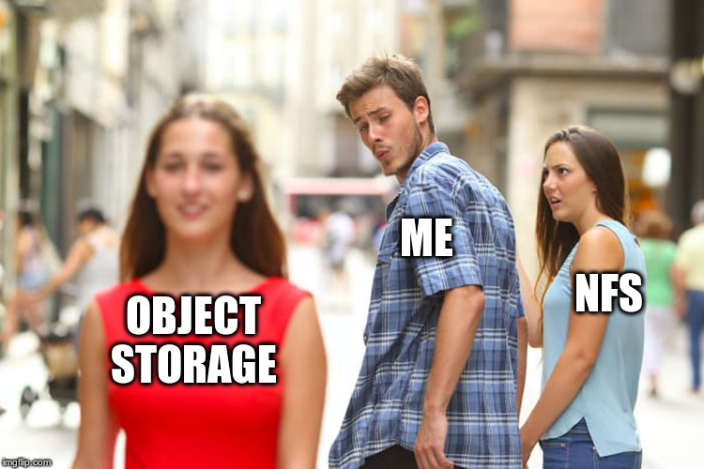
Motivation
Traditional file systems do not scale well for AV
SAN is complicated (and $$$)
Redundancy or Performance? Pick one
Microservices do not like filesystems
Notes:
What motivation is there behind actually pursuing a completely different way how to work with files?
Well, traditional file systems tend not to scale well for audiovisual purposes..The storage subsystem is either large and slow, or small and fast, right?
Trying to overcome this, usually the clustered storage solutions in digital preservation are based around SAN model, where there is a clear physical path between client and server (usually iSCSI or Fibre Channel).
This is complicated from an infrastructure stand point and tend to be a bit pricey as well.
You get to choose between two ends - Data redundancy or Performance? You choose.
Last but not least, traditional file system access was not invented with microservices, and the whole service mesh concept in mind, thus implementation into these systems is usually non-trivial.

Slide 3
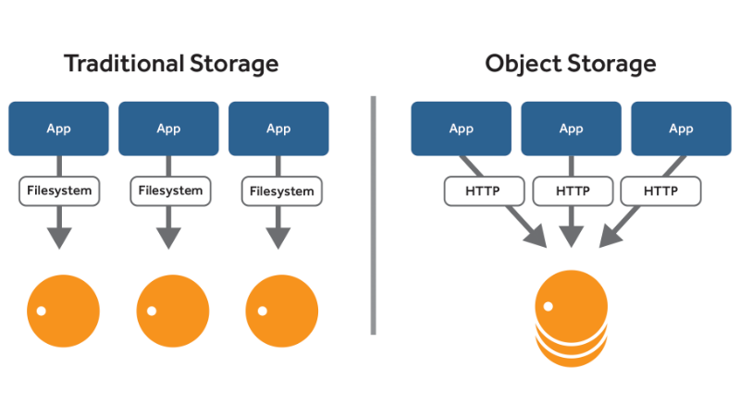
What’s an “object storage” anyway?
Data as objects, instead of files
Object is UUID + data + metadata
Web APIs as a storage abstraction (usually REST API)
Top-level folder = Bucket
“Folders” are just metadata
Source: doc.aws.amazon.com
Notes:
So, what is an object storage anyway? It’s a storage service, from which data is retrieved on a per-object basis. One can look at object like a small archival package, where not only data, but also arbitrary metadata is present. This differs from a filesystem where every file has only a fixed set or parameters defined by the file system itself. Therefore, object storage is a bit like a database for files, from where you read and write them via Web APIs. Any program capable of HTTP communication therefore can access them directly, supposing it has the right credentials. On object storage, one can have multiple root folders, (so-called ‘Buckets’), for principal content differentiation. Speaking of folders, physically there are none, they are present only in the form of metadata, to emulate traditional folder-based paradigm.

Slide 4
A word about security
No more “security by obscurity”
Whole data storage is accessible via REST API
Access control via secrets present in every HTTP/S request
Tighter access-control requirements
Notes:
The barrier between data residing someplace, and an app residing elsewhere then becomes a matter of access-control, rather than how to make data accessible. To properly access data, one must provide a secret (most usually two variables resembling username and password) in every HTTP request. This requires some effort on the developer side to properly safeguard those secrets, supposing the object storage is publicly accessible.

Slide 5
Multiple implementations, one API
Hosted
Amazon S3
Google Cloud Storage
..
On-premise
Ceph
MinIO
OpenIO
Notes:
Even though there are many implementations of object-storage model, they all share the same system, and in majority also the API. The API is called S3 (for Super Simple Storage), which is a de-facto standard due to the fact that original implementation of Amazon’s hosted product (called S3) has become an industry-standard not long after it’s adoption. Fortunately, there are not jut proprietary hosted (so-called cloud) solutions, but open-source implementations exist which anybody can run on their own. They differ in robustness, scalability and complexity. In národní filmový archiv, we implemented one of them - MinIO

Slide 6
MinIO
“Do one thing, and do it well”
Written in Go, one binary
Data chunking as a way towards parallelization
Multi-GB/s speeds on commodity hardware w/spinning disks
Inherent redundancy and bit-rot protection
Both standalone and cluster-aware
Notes:
So what’s MinIO? It’s an S3 storage server, build with simplicity in mind. It follows ‘Do one thing, and do it well’ UNIX philosophy, given the fact it is written in Go (a language co-invented by one of the UNIX pioneers), which compiles to one sole binary. S3 servers try to remove the burden of working with large files by splitting them into several pieces and working with them in parallel, and MinIO is no exception. This enables multi gigabyte read or write speeds on spinning disks, as the chunks are split between the underlying disks, multiplying the performance. To take it even further, it employes Erasure coding to ensure data is duplicated for redundancy, and corrupt chunks are replaced on-the-fly. MinIO can run both in standalone mode on a physical server with, say, a 60-drive JBOD, or in clustered mode with hunderts of containers, every with it’s own data storage.

Slide 7
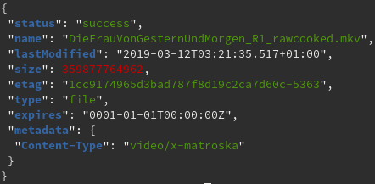
Fixity
S3 API enforces checksum calculation and retention
Data chunking speeds things up by calculating hashes in parallel
MD5 hash function (so-2000’s)
Hash in every HTTP response
https://github.com/antespi/s3md5
Notes:
S3 API has mandatory fixity requirements, which enforces checksum calculation during data ingest, and it’s retention during life of the object.
When chunking is used, hashes are calculated in parallel, and those are then hashed together, calculating “a hash of hashes”.
S3 spec uses MD5 function, which is slightly outdated now (as the API is stable since 2006..), but better than no hash at all.
The resulting checksum is directly available to the application, and is present in every HTTP response from the S3 API, to detect any changes made to the data.
There is a tool called ‘s3md5’ which can be used to verify fixity of local copy of the data against the API

Slide 8
Redundancy and bit-rot protection
MinIO supersedes RAID by employing Erasure coding
$ minio server /mnt/disk{1..32}
Configurable redundancy (N/2 + 1 by default)
Even when half of drives +1, still able to write to it
Uses HighwayHash internally (up to 10GB/s on single core)
Automatic bit-rot detection and correction
Notes:
MinIO is able to hold the data in several locations for redundancy, so there is no need for proprietary RAID anymore, as the function is superseded by Erasure code algorithms.
When starting the server, one has to specify a list of directories where minio should make the storage. It is expected those will be empty disk mounts, but can be any directory as well.
The redundancy ratio is configurable, but the default is configured in the way that if even half of the drives are gone, data can still be accessed. Write access needs majority of the drives though.
MinIO’s Erasure coding is based on a very fast algorithm called HighwayHash, which is able to hash multiple gigabytes per second on single CPU core.
When the system detects an error in one of the chunks, it will automatically reconstruct it from the other parts present in the system, be it bit-rot or a crashed disk, which was just replaced.

Slide 9
WORM mode
Write once, read many
Only read and write, no delete/move/overwrite
Notes:
MinIO also has the ability to enforce a global WORM mode (worm stands for “Write once, read many”), which means the storage provides only Read and Write APIs, nothing else.
This further enforces data retention, as no application is able to modify the data after it has been ingested.

Slide 10
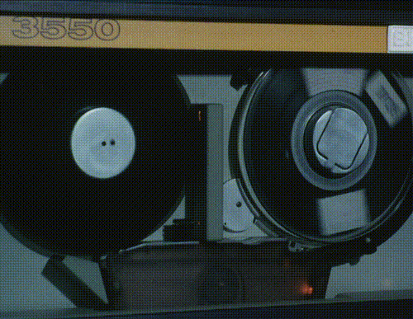
Classical Filesystem interface
For some workflows, filesystem interface is required
S3 has a wrapper implementation (FUSE, mostly POSIX-compliant)
Retains parallelization benefits
Metadata access is expensive though (no DPX sequences please..)
https://github.com/s3fs-fuse/s3fs-fuse
Notes:
When working with AV material directly, like playing it, or post production workflows, API access is not yet feasible.
Luckily, S3 API has several wrapper implementations (for example Filesystem in Userspace), which enable to work with object-storage buckets like with any other filesystem.
This mode of access retains the benefits of parallelization, but must be carefully used. Especially in operation with frequent or parallel metadata access, this can be a problem due to the fact the metadata retrieval is relatively expensive, compared to data access. One good example is a folder full of DPX files, which I wouldn’t recommend to store on object-storage. Rather compress them with RAWCooked!

Slide 11
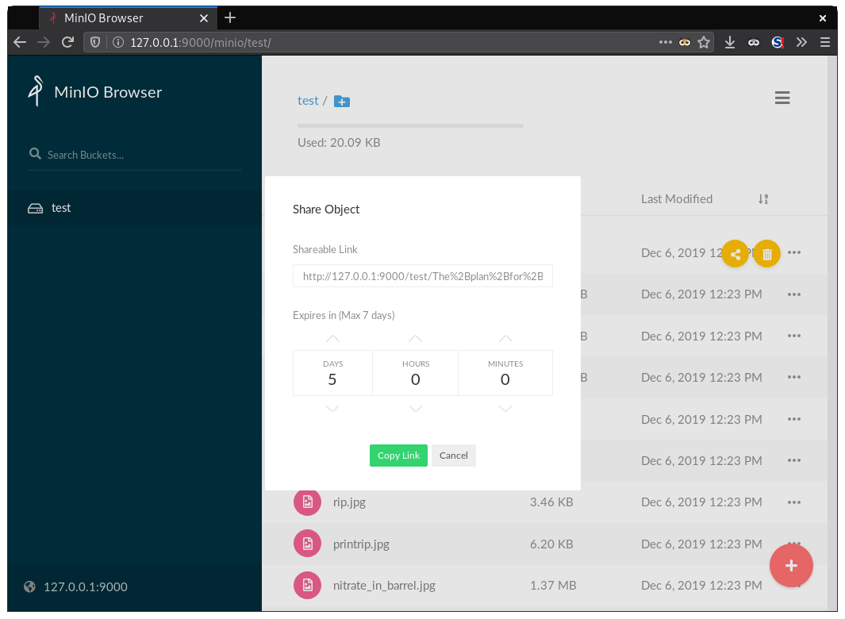
Tools
Native Web UI
CLI client - mc
S3cmd
Cyberduck
..
Notes:
Every data storage service needs some tools to to housekeeping tasks, and object-storage is no exception. MinIO itself has two clients - a Web UI (which is available by default as it is a part of the binary), and also a command line client called mc. The tool tries to emulate standard POSIX commands like copy, move, find, et cetera..There are several other client applications, like s3cmd, which is also commandline-based, and for GUI-lovers, there is always the all-mighty Cyberduck.

Slide 12
Links
https://github.com/minio/minio
https://docs.aws.amazon.com/AmazonS3/latest/API/s3-api.pdf
https://github.com/google/highwayhash
https://github.com/s3fs-fuse/s3fs-fuse
https://github.com/antespi/s3md5
Notes:
This concludes my quick overview, and here are just some links for your studying pleasure.

Slide 13
Thank you
jonas.svatos@nfa.cz
github.com/NFAcz
Notes:
Thank you, if you have any questions, please ask me now or I’ll be around.

